Slide 1
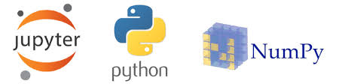
Python for Physics
By
Rabia Tabassum
Assistant Professor

Slide 2
Key topics Covered
Introduction to Jupiter Notebook .
Introduction to Basics of Python.
Python libraries ( Numpy and Matplotlib)
Programming the main topics of Physics:
Vectors
Motion & Free Fall Motion
Projectile motion
Simple Harmonic Motion & Damped Oscillation
Circular Motion &SHM
Wave Motion
Electrostatics Force and Field
Gravitational Field

Slide 3
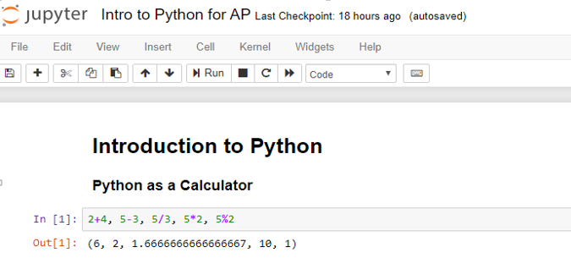
Introduction to Python

Slide 4
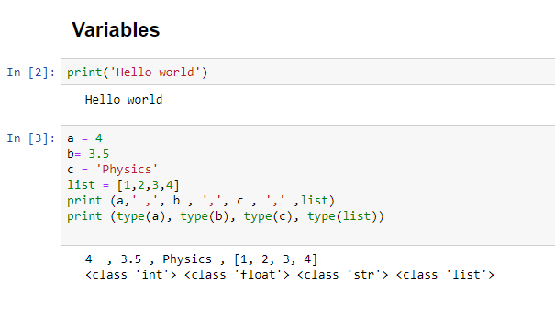

Slide 5
Reserved Words
You cannot use reserved words as variable names / identifiers
False class return is finally
None if for lambda continue
True def from while nonlocal
and del global not with
as elif try or yield
assert else import pass
break except in raise

Slide 6
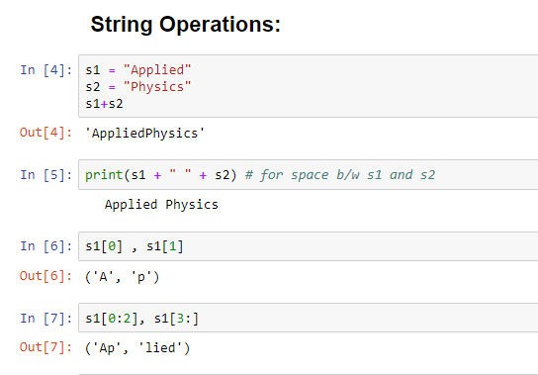

Slide 7
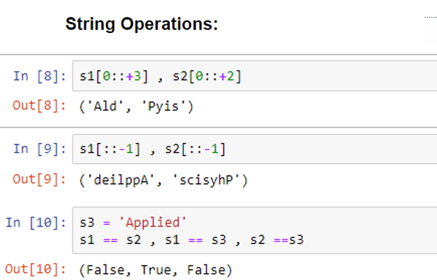

Slide 8
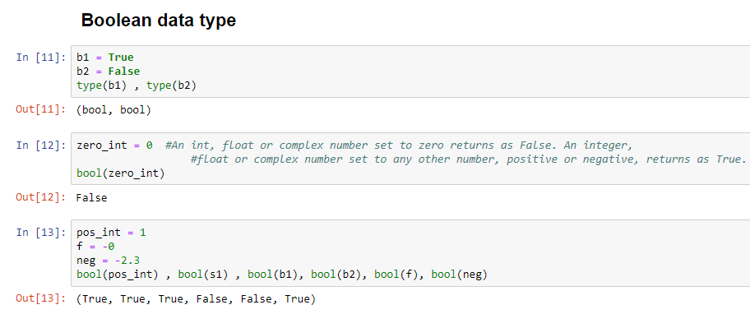

Slide 9
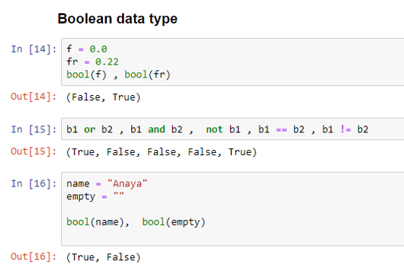

Slide 10
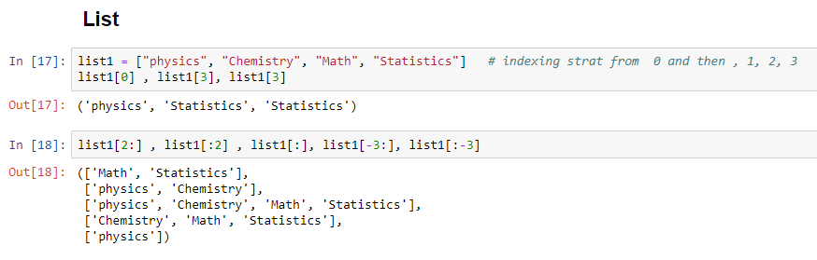
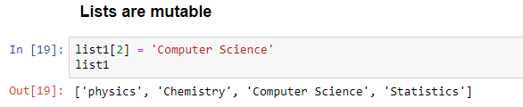

Slide 11
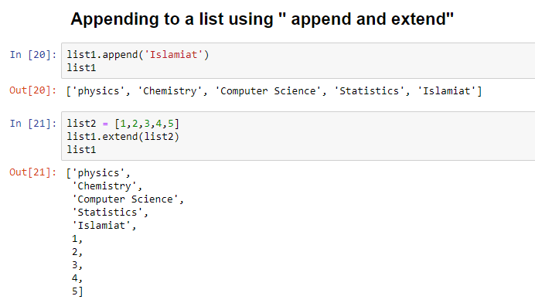

Slide 12
